Slide 1
NFL player data analysis
Data visualization Final project
Daria Chylak, mph
GWU, mS candidate, bioinformatics
December 2019

Slide 2
dataset
Data was acquired via
pro-football-reference.com
Offensive statistics and personal information (height/weight/dob/combine info/college/conference) for NFL players from 1999-2013
Additional data on cte came from:
Evaluation of chronic traumatic encephalopathy in football players, jama, 2017. by Ann Mckee.
Data was cleaned
Players with missing data were removed
Used bootstrap, html, and tableau for vizualization

Slide 3
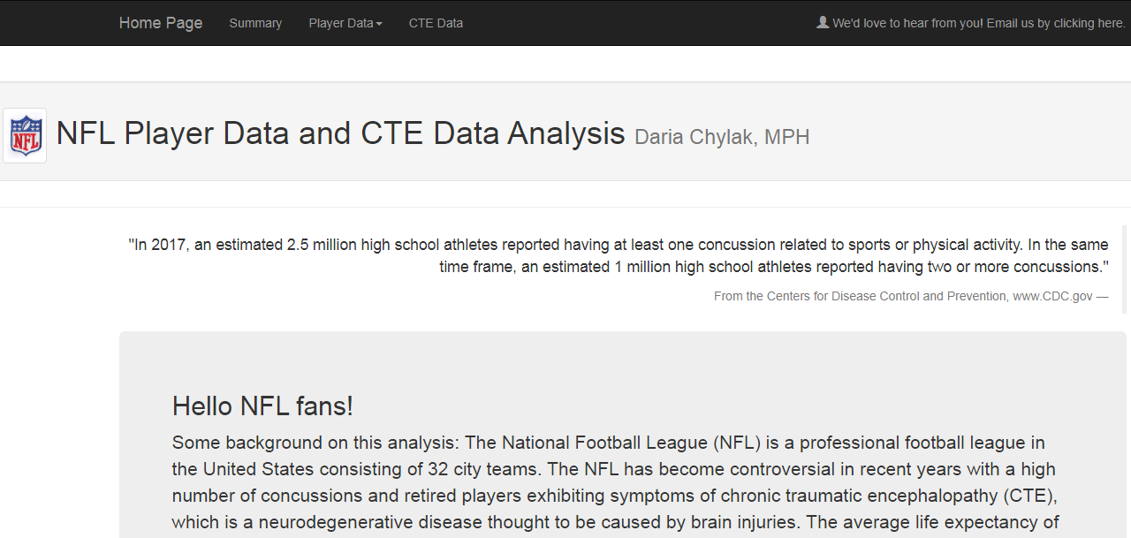
Home Page - includes short introduction, link on top right of screen to send an email to developer team, tabs and drop down on top left to toggle between pages

Slide 4
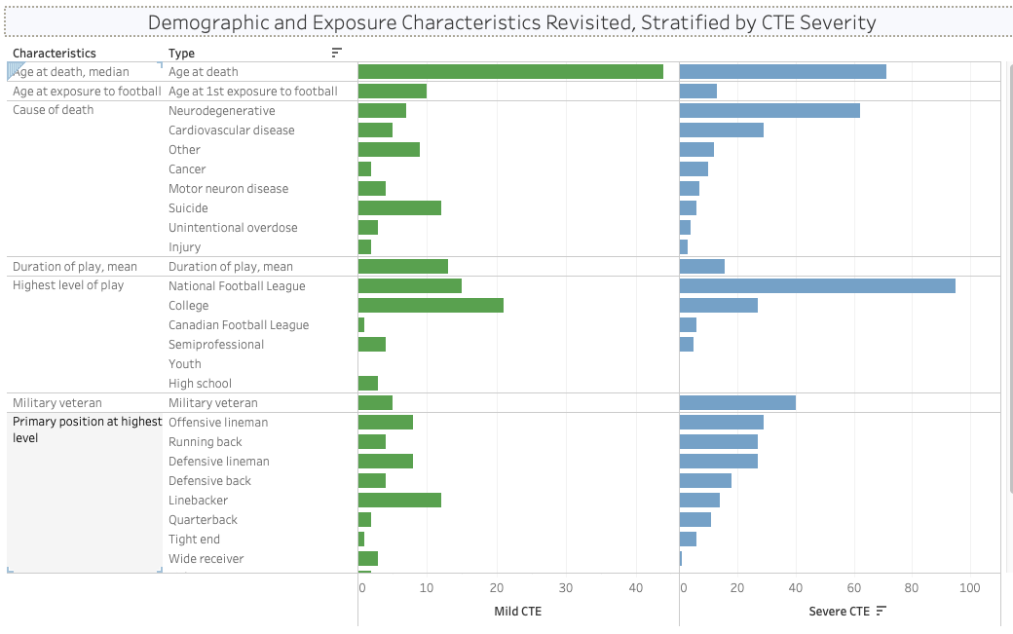
Demographic and exposure characteristics

Slide 5
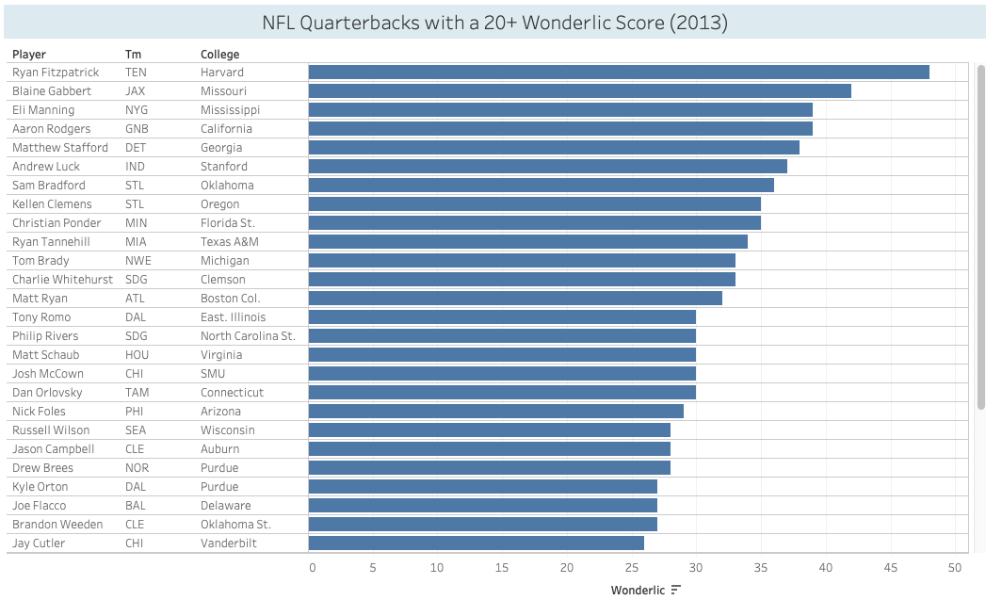
NFL Wonderlic Scores

Slide 6
Questions?

